Slide 1
Spray Droplet Size and Drift
Bob Wolf - Kansas State University / Biological and Ag. Engineering
Bobby Grisso - VA Tech / Biological Systems Engineering
Pat Hipkins - VA Tech / VT Pesticide Programs
Tom Reed - Spraying Systems / TeeJet Northeast

Slide 2
Relationship of Drift to Drop Size:
The smaller the droplet, the greater the odds of particle drift.

Slide 3
Spray droplets are:
  measured in microns (μm)
  described by Volume Median Diameter (VMD)

Slide 4
Units
One micron (μm) =1/25,000 inch
VMD = 50% of the spray volume is made up of droplets less than the VMD, and 50% is made up of droplets greater than the VMD.

Slide 5
Size Comparison:
Diameter of Common Items (approximate) in Microns
2,000 μm
850 μm
420 μm
300 μm
150 μm
100 μm
#2 pencil “lead”
paper clip
staple
toothbrush bristle
sewing thread
human hair
200 μm
Notes:
200 microns is about the midrange droplet size of a fine droplet (Droplet Size Category Chart: Approximate VMD Range of a Fine Droplet = 145-225)

Slide 6
1/2 of spray volume = smaller droplets
VMD
1/2 of spray volume = larger droplets
Notes:
VMD = Volume Median Diameter = a value where 50% of the total VOLUME or mass of liquid sprayed is made up of droplets LARGER than the median value and 50% SMALLER than this value.
For example, if the VMD is 300 microns, half of the VOLUME of the spray is in droplets bigger than 300 microns, and half of the spray VOLUME is in droplets smaller than 300 microns.

Slide 7
1/2 of spray volume =
MORE small droplets
VMD
1/2 of spray volume =
FEWER large droplets
Notes:
VMD = Volume Median Diameter = a value where 50% of the total VOLUME or mass of liquid sprayed is made up of droplets LARGER than the median value and 50% SMALLER than this value.
HOWEVER, the number of droplets is a different story. For example, if the VMD is 300 microns, more than half the droplets produced by a nozzle will be < than 300 microns, and less than half of them will be > 300 microns.

Slide 8
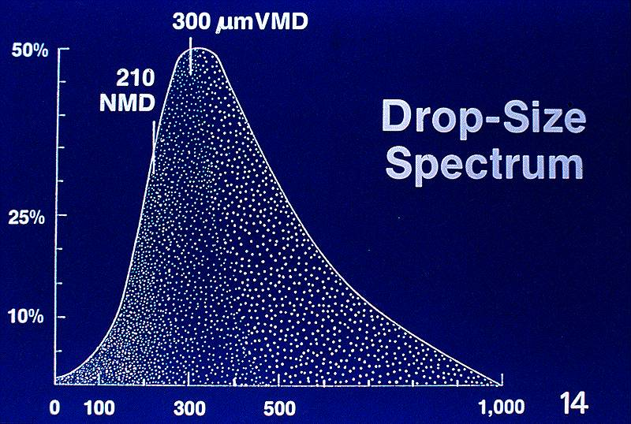
Nozzle Spray Spectrum
NMD = number median diameter
VMD = volume median diameter
Notes:
NMD = number median diameter, which is NOT necessarily the same as the VMD, as shown.
This droplet’s VMD is 300 microns, which means that 1/2 the spray VOLUME is made up of droplets smaller than 300 microns, and 1/2 of the volume is made up of droplets larger than 300 microns.
HOWEVER, the size at which half the NUMBER of droplets are larger/smaller is 210…meaning, in this case, that there are (relatively) more smaller than larger droplets produced by this tip.

Slide 9
Cutting Droplet Size in Half
Results in Eight Times the Number of Droplets
250
Microns
250
Microns
500
Microns
250
Microns
250
Microns
250
Microns
250
Microns
250
Microns
250
Microns
Notes:
You can show this-- or have course participants to this activity -- quickly and easily with two jars of Play-Doh and a plastic ruler:
At the start of the activity, roll two containers of Play-Doh* (or clay) into two balls/spheres of equal size.
I tell participants the task at hand is to show the effect of reducing spray droplet size (diameter), using Play-Doh to simulate spray droplets…and I ask them to predict how many “droplets” will be formed when I reduce the diameter of the Play-Doh sphere by half. Most guess two or four.
Place one of the balls on a ruler and measure its diameter. Use it as a reference. Divide the other one in half by volume, and roll the two pieces into spheres. Measure them. Continue subdividing until you produce a set of spheres that are half the size of the reference one.
*TIP: A “standard” tub of Play-Doh [3” tall] will roll into a sphere 6 cm in diameter. After the first division, the two “droplets” produced measures ~ 5 cm in diameter. After the second division, the four balls measure 4 cm, and finally, after the third division, each of the eight “droplets” produced measure 3 cm = half the size of the reference sphere.

Slide 10
Cutting Droplet Size in Half
Results in Eight Times the Number of Droplets
=
500
Microns
250
Microns
1 more droplet (rear center)
fills in the sphere

Slide 11
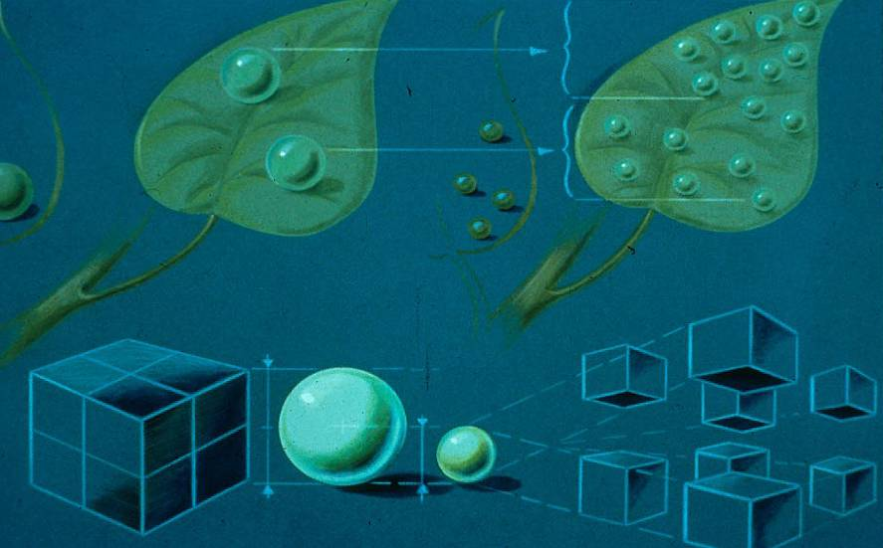
1/2x droplet diameter = 8x number of droplets
Notes:
This shows the difference in coverage….

Slide 12
Spray Characteristics:
Comparisons:
for a given / fixed volume:
  droplet diameter
  number of droplets
  surface area
Notes:
So…when you reduce droplet size, what happens?! What do you gain -- and what can go wrong (what do you lose or give up)?

Slide 13
Diameter Comparison
Droplets =
  500 μm
  250 μm
  125 μm

Slide 14
Given: Spray Volume = 0.065 mm³
1 droplet = 500 μm in diameter
8 droplets = 250 μm in diameter
64 droplets = 125 μm in diameter
(Volume of a sphere = 4/3 π r³)
Notes:
A given spray / liquid volume of 0.065 mm³ can produce:
One big drop (500 microns) OR 8 droplets half that size (250 microns) OR 64 droplets one-fourth the size of the 500-micron one you started with.

Slide 15
For a given volume: droplet diameter + number comparison
0.065 mm³ =
  1 @ 500 μm:
  8 @ 250 μm:
  64 @ 125 μm:

Slide 16
Constant Volume:
1 droplet : 8 droplets : 64 droplets
Spray Volume
Notes:
All of the possibilities shown in the previous slide:
1 500-micron droplet,
8 250-micron droplets, and
64 125-micron droplets:
ALL have the same VOLUME: in this case, 0.065 mm³.

Slide 17
Constant Volume:
1 droplet : 8 droplets : 64 droplets
Notes:
However, the number of droplets varies considerably:
1 500-micron droplet,
8 250-micron droplets, and
64 125-micron droplets:
Although each scenario (1@500, 8@250, and 64@ 125 microns) has the same VOLUME-- in this case, 0.065 mm³. -- the difference in droplet number and size results in a big difference in surface area.

Slide 18
For a given volume: surface area comparison
0.065 mm³ =
  1 @ 500 μm = 785,400 μm²
  (785,400 μm² x 1)
  8 @ 250 μm = 1,571,000 μm²
  (196,300 μm² x 8)
  64 @ 125 μm = 3,142,000 μm²
  (49,100 μm² x 64)
Notes:
The formula for calculating the surface area of a sphere is 4πr².

Slide 19
For a given volume: surface area comparison
Surface Area
Notes:
Smaller droplets have more surface area per unit volume. Reducing the droplet size by half doubles the surface area.
The amount of surface area is important because it influences evaporation rate. The greater the surface:volume ratio, the more quickly a droplet will lose water -- and become smaller -- due to evaporation.

Slide 20
Summary: Droplet Size
At a given application volume, using fewer larger droplets is LESS likely to result in drift….because large droplets are
  Harder to move off-target
    (heavier)
  Slower to evaporate / volatilize
    (low surface: volume ratio)

Slide 21
What is the “Real” difference ?
In SIZE (diameter):
  Medium droplet at 250 microns
  vs.
  Coarse droplet at 350 microns
350
250
= 1.4
140 % bigger
Notes:
By increasing droplet size from medium* to coarse*, you make it almost 1.5 times bigger in size….
-----
[*In this example, the droplet size used in the example is at the low end of the range. Medium = 226 – 325 microns; coarse = 326 – 400 microns.]
----------
Bob Wolf writes: I use these slides to show that it doesn’t take much of an increase in size (diameter) to make a big difference in the volume and, thus, the weight of a droplet. Volume is three-dimensional and is a cubic function.
Volume increases at a faster rate than diameter does, because it is three-dimensional, while diameter is one-dimensional.
For example, given two droplets: A medium droplet of 250 microns vs. a coarse droplet at 350 microns:
350/250 = 1.4 = The 350-μm droplet is 140 % (1.4 times) bigger (in diameter)…

Slide 22
In VOLUME (and WEIGHT):
  Medium droplet ≈ 8,177,083 μm³
  vs.
  Coarse droplet ≈ 22,437,917 μm³
22,437,917
08,177,083
= 2.74
274 % bigger
The 350-micron drop is 140% bigger in diameter,
but 274% bigger in volume (and weight)!
Notes:
However, this same changes increases the amount of liquid in the droplet by almost 3 times!
-----
The volume of a 250-μm medium drop ≈ 8,177,083 μm³ vs. that of a 350-μm coarse drop ≈ 22,437,917 μm³ . (The formula for volume of a sphere is 4/3 π r³.)
22,437,917 / 8,177,083 = 2.74; hence, the 350-μm droplet is 274 % bigger in volume…no matter what the droplets are composed of, assuming they’re both made of the same substance, the bigger droplets will be proportionally heavier.
Weight is directly proportional to -- and dependent on -- volume because it is based on the volume of the drop and substance the drop is composed of.

Slide 23
Why is Droplet Size Important?!
Coverage
Drift
Notes:
A tradeoff…

Slide 24
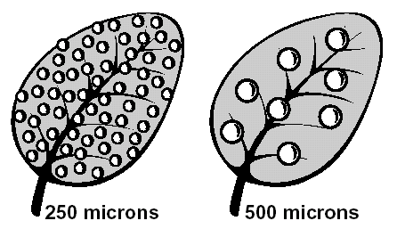
Droplet size and surface coverage:
64 250-micron droplets vs. 8 500-micron droplets
Notes:
This is just a quick “snapshot” of what would happen if you reduced droplet diameter by 1/2 -- in this case, from 500 to 250 microns…thus increasing droplet number by 8x (8 x 8 = 64) from right to left . You have the same amount of liquid on both leaves but applied differently, with different coverage.

Slide 25

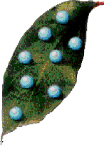
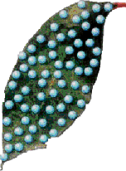
Droplet size and surface coverage:
500 microns = 1
250 microns = 8
125 microns = 64
Notes:
This is another look at the same thing, this time in three steps, reducing droplet diameter by 1/2 each time -- from 500 to 250 microns (1 droplet to 8 droplets) and from 250 to 125 microns ( 8 droplets to 64 droplets). Again, you have the same amount of liquid on each leaf but applied differently, with very different coverage.

Slide 26
Droplet size and drift:
Distance Water Droplet Drifts -- falling 3 ft
Droplet Size | Microns | Drift (ft)
Extremely Coarse | 600 | 0.20
Very Coarse | 500 | 0.30
Coarse | 400 | ~ 0.5
Medium | 300 | ~ 1.3
Fine | 200 | ~ 5
Very Fine | 100 | ~ 25
Ultra Fine | 50 | ~ 45
Wind speed 5 mph, RH 75%, Temp. 75^{O}F; 30 psi
Notes:
Values obtained using DriftSim: 2005, Bulletin 923; THE Ohio State University Extension
DriftSim Authors: Heping Zhu and Robert D. Fox (USDA-ARS Application Technology Research Unit, Wooster, OH) and H. Erdal Ozkan (Food, Agricultural, and Biological Engineering Department, THE Ohio State University, Columbus, OH)
Point out the huge difference between the XC, C, and C droplets (ivory), M droplet (light yellow), F droplet (yellow), and VF and UF droplets (orange)
Distance Water Droplet Drifts -- falling 3 ft: exact model values
Droplet Size Microns Drift (ft)
Extremely Coarse 600 0.20 (2.4”)
Very Coarse 500 0.30 (3.6”)
Coarse 400 0.49 (5.88”)
Medium 300 1.28 (1 foot + 3.4”)
Fine 200 4.89
Very Fine 100 24.84
Ultra Fine 50 44.72

Slide 27
Droplet Size and Drift
Hoffman et al., 1986; wind speed 1mph, 75º F, 55% RH
Notes:
Hoffman et al., 1986 -- from Spray Drift of Pesticides; NebGuide G 1773, September 2007; Klein, Schulze, and Ogg
Red dot indicates the distance at which the droplet disappears (water evaporates).

Slide 28
Droplet Size and
Evaporation / Deceleration
Droplet
Terminal
Final Drop
Time to
Distance
Traveled
Diameter
Velocity
Diameter
Evaporate
(microns)
(ft/sec)
(microns)
(sec)
(in)
20
0.04
7
0.3
<1
50
0.25
17
1.8
3
100
0.91
33
7.0
9
150
1.70
50
16
16
200
2.40
67
29
25
90º F, 36% RH, 25 psi, 3.75% pesticide solution
Notes:
Smaller droplets have more surface area per unit volume, therefore more surface exposed to air/wind = faster evaporation.
Experimental Conditions:
• Temperature: 90º F
• Relative humidity: 36%
• Spray pressure: 25 pounds per square inch
• Pesticide solution: 3.75%
COLUMN 3 = Final Drop Diameter (in microns) after dropping # of inches given in COLUMN 5 from nozzle. COLUMN 5 = Distance Traveled from Nozzle (in inches)
Source: Strategies to Reduce Spray Drift, Kansas State University Application Technology Series, Robert E. Wolf, Extension Agricultural Engineer, KSU; MF 2444, March 2000.

Slide 29
Droplet Size and Drift
Large droplets have less drift potential because they are:
  heavier and drop / fall faster
  evaporate slower
  less affected by wind
Notes:
Gravity affects all objects and is not dependent on their mass (weight.) HOWEVER, force = mass times acceleration. Hence, heavier objects are propelled with more force than lighter ones. Once expelled from a nozzle, big, heavy droplets are subject to more force than smaller, lighter ones…so they do move/drop faster.
The greater the surface : volume ratio, the more opportunity for evaporation. Hence, smaller droplets evaporate more rapidly than larger ones.
The heavier the droplet, the more force (wind) it takes to move it…so larger droplets are not as likely to be blown off-target as are smaller ones.

Slide 30
Droplet Size and Drift
High Relative Humidity,
Low Temperature
Low Relative Humidity,
High Temperature
Wind
Notes:
This simple slide illustrates the effect of temperature and humidity (and as a result, evaporation), and wind on droplet size…and drift! The white arrow measures /indicated the amount of displacement/drift. This summarizes, in graphic form, what the tables and text (slides 24-27) say.

Slide 31
Droplet Size Management
Small droplets often result from:
  high spray pressures
  small nozzle tips/orifices
  wind shear across the nozzles
Nozzle design also affects droplet size

Slide 32
Drift Potential Is Influenced by
Nozzle / droplet
  Volume Median Diameter (VMD)
  Spectrum (range: big to small)
To minimize the risk of drift, avoid using nozzles that will create an increased % volume of droplets < 200 microns (VD0.1)

Slide 33
Important Droplet Statistics:
VMD
(50%)
or
Vd0.5
Operational Area
VD0.1
(10%)
VD0.9
(90%)
Notes:
Bob Wolf writes:
“This slide shows the complete picture. What it shows us is a typical droplet spectrum when it is measured…the old “bell-shaped” curve. I always have fun with this slide. I liken it to a set of test scores in school. Since everyone has taken a test at one time, applicators can relate to that comparison. VMD alone is meaningless when it comes to describing drift potential. All we know is that if the VMD is smaller the tendency would be for the VD0.1 to also be higher. Thus we are trying to educate more today about the VD0.1.”
However, Bob says that the literature and technical information about nozzles/operating pressures do not always discuss relative span or give the VD0.1. Ag Engineers (ASABE) and /nozzle manufacturers are working on that issue.
Bob Wolf uses this slide to help emphasize the need to reduce the number of fines or shift the VD0.1 to the right (toward the middle) of this curve…which is what we are emphasizing in talking about droplet characteristics using this slide set.
The series of slides that follow further illustrate what’s meant by VD0.1 and relative span.
NOTE: Depending on the technical background and interest level of your audience, you may or may not wish to use slides 33-37.

Slide 34
Comparison:
Three different applications:
droplet spectra
100 200 300 400 500 600
Notes:
Here is a graph showing the droplet distribution/relative span for three different scenarios / spray applications.
For each, the VMD is the same (300) microns). However, they don’t have the same VD0.1 -- or drift potential!
Orange line: droplets range from ~ 25-600 microns in size;
Yellow line: droplets range from ~ 100-500 microns in size;
Maroon line: droplets range from ~ 200-500 microns in size.

Slide 35
Relative Span
RS = (VD0.9 – VD0.1)/VMD
VD0.9 = 400, VMD = 300, VD0.1 = 100 (A)
VD0.9 = 625, VMD = 300, VD0.1 = 25 (B)
VD0.9 = 500, VMD = 300, VD0.1 = 200 (C)
Notes:
Relative span is used to describe the ratio between the large droplet portion (VD0.9) and the small droplet portion (VD0.1) of a nozzle’s droplet spectrum as it relates to VMD. The formula is shown above (top / white box). What we know is that the VMD doesn’t really tell us anything about the amount (number or volume) of smaller -- or larger -- droplets.
In the industry, a good relative span value = “1”.
In the three examples given, the VMD is the same (300 microns).
However, one (A) has a VD0.1 of (10% volume less than) 100 microns -- not too bad … while another (B) has a VD0.1 of 25 -- meaning 10% of its volume is made up of droplets that are less than or equal to 25 microns! The one with the VD0.1 of 25 will have a greater drift problem, because 10% of its volume is 25 microns or less. The one with the VD0.1 of 100 microns -- or 10% of the spray volume equal to 100 microns or less -- will have fewer driftable fines. Thus, the smaller the VD0.1, the greater the drift potential.
The industry usually considers anything under 200 microns VD0.1 as highly driftable. With that in mind, neither droplet spectrum (A) or (B) is acceptable -- but (A) is better than (B).
[ (C) is ideal/perfect. ]
Advances in nozzle technology and recommendations in operating pressures are attempting to raise the VD0.1 to numbers in the > 200 micron range….thus reducing drift.

Slide 36
Relative Span
RS = (VD0.9 – VD0.1)/VMD
RS (A) = (400 - 100) ÷ 300 = 300 ÷ 300 = 1
RS (B) = (625 - 25) ÷ 300 = 600 ÷ 300 = 2
RS (C) = (500 - 200) ÷ 300 = 300 ÷ 300 = 1
Notes:
Here are the calculations for the relative span of the three different scenarios illustrated/graphed on slide #34. Note that the one in the middle -- (B) -- is 2X the value as (A) and (C).
In the industry, a good relative span value = “1”.
That is true with the first example above (A); 400-100/300 = 1 = relative span. The problem with droplet distribution (A) is that the VD0.1 is lower than ideal (100 microns vs. at or greater than 200 microns).
However, a better example would be: VD0.9 = 500, VMD = 300, VD0.1 = 200, as illustrated by C: relative span = 1 -- AND VD0.1 = 200 microns.

Slide 37
Relative Span: Visual Comparison
A = yellow
B = orange
C = maroon (ideal)
100 200 300 400 500 600 700
Notes:
This graph, again, shows droplet distribution/relative span for three scenarios.
For each, the VMD is the same (300) microns). However, they don’t have the same VD0.1 -- and the smaller the VD0.1, the greater the drift potential.
(A): yellow line
VD0.9 = 400 microns (10% of the spray volume is equal to or greater than 400 microns)
VD0.1 = 100 microns (10% of the spray volume is equal to or less than 400 microns)
Spray application A -- with a VD0.1 of 100 microns -- will have fewer driftable fines than application B.
(B): orange line
VD0.9 = 625 microns (10% of the spray volume is equal to or greater than 625 microns)
VD0.1 = 25 microns (10% of the spray volume is equal to or less than 25 microns)
This spray application will have a greater drift problem, because 10% of its volume is 25 microns or less.
(C): Maroon line
VD0.9 = 200 microns (10% of the spray volume is equal to or greater than 200 microns)
VD0.1 = 500 microns (10% of the spray volume is equal to or less than 500 microns)
This spray application has NO highly driftable droplets (those less than 200 microns) and a relative span of “1” (500-200/300 = 1)

Slide 38
Droplet Size Categories
Initiated by BCPC (British Crop Protection Council)
Adopted by ASABE (American Society of Agricultural & Biological Engineers) - Standard 572
Assigns a spray tip (at a given pressure) to a droplet size category based on spray characteristics
  Nozzles are tested using a prescribed protocol against a standard set, which allows for comparisons
  In order to market their tips, manufacturers must have all nozzles tested as described above
In the future, pesticide labels will have droplet size category recommendations/requirements

Slide 39
Droplet Size Categories
Category | Symbol | Color Code | Approximate VMD Range*
Very Fine | VF | Red | < 145
Fine | F | Orange | 145 – 225
Medium | M | Yellow | 226 – 325
Coarse | C | Blue | 326 – 400
Very Coarse | VC | Green | 401 – 500
Extremely Coarse | XC | White | > 500
* These numbers vary widely, based upon the type of laser analyzer used.
Notes:
Volume Median Diameter (VMD)

Slide 40
Droplet Size Comparison
Symbol | Color Code | VMD Range | Comparative Size
VF | red | < 145 | human hair (100μ) | ●
F | orange | 145-225 | sewing thread (150μ) | ●
M | yellow | 226-325 | drizzle | ●
C | blue | 326-400 | light raindrops | ●
VC | green | 401-500 | staple (420μ) | ●
XC | white | > 500 | heavy raindrops | ●

Slide 41
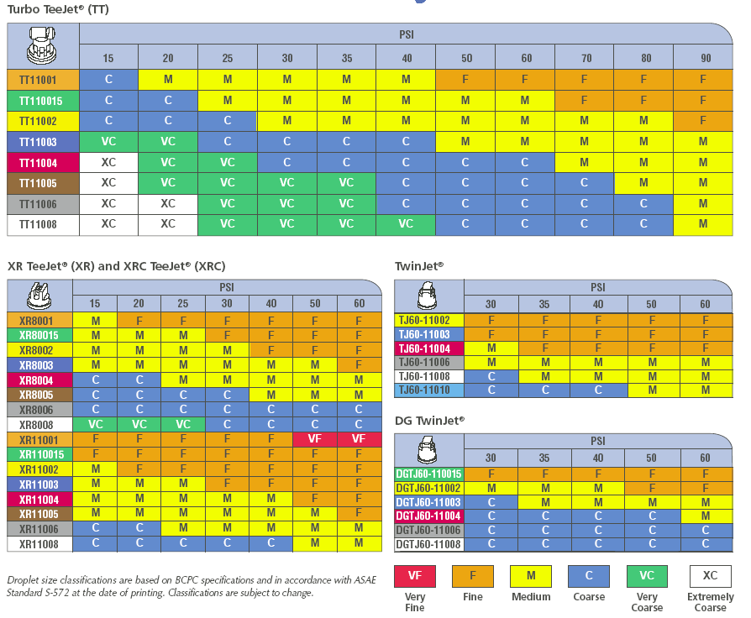
Ex.: Nozzle Classification Chart

Slide 42

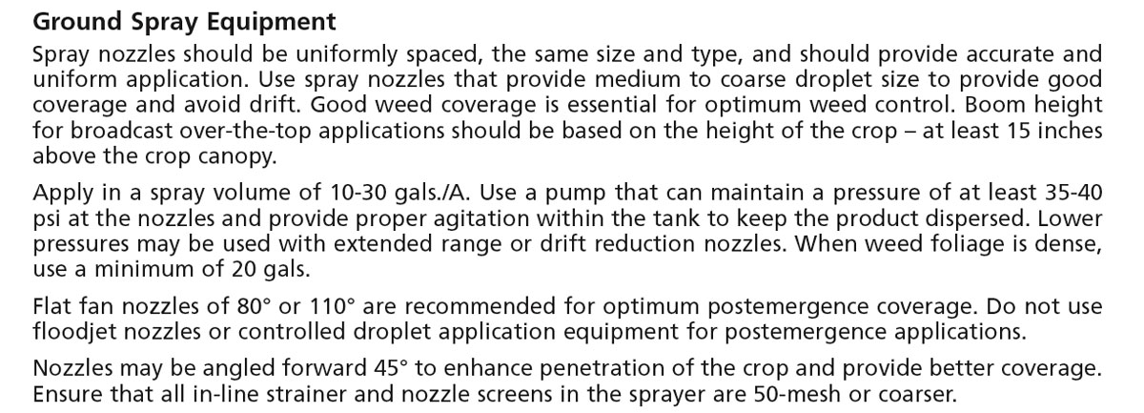
Droplet Size - Label
Notes:
Some labels have a great deal of information regarding drift management, including specific instructions or recommendations regarding buffer zones and nozzle selection and sprayer/equipment configuration and operation. In addition, many have wind speed restrictions and other limits on environmental conditions (temperature and humidity; inversions) during application.
However, more and more labels have SPECIFIC information regarding nozzle selection and droplet size, as shown here.

Slide 43
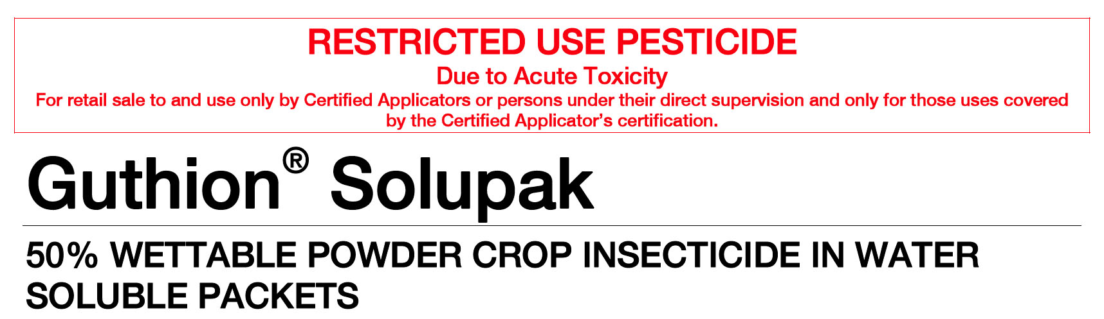
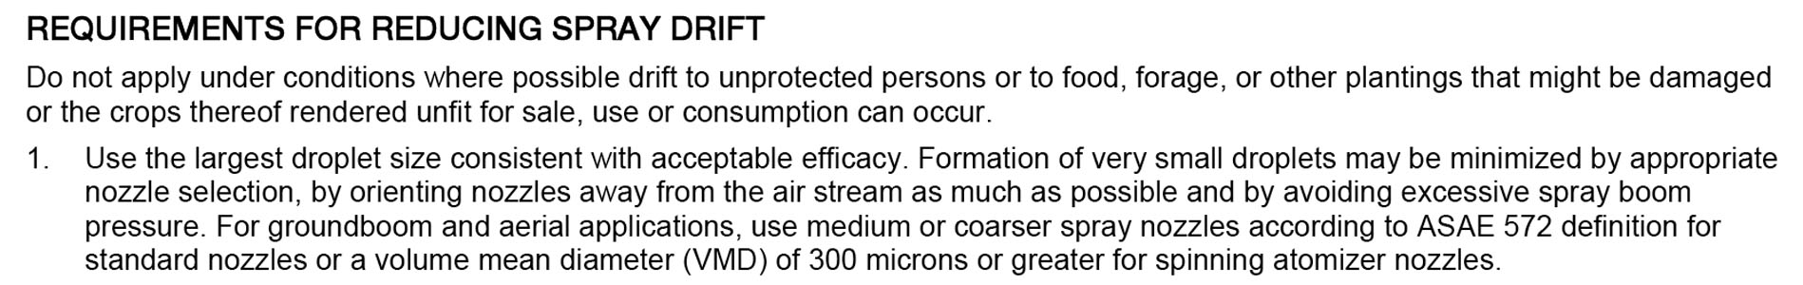
Droplet Size - Label
Notes:
VMD stands for Volume Median Diameter.
Note that this product label mistakenly calls VMD the Volume Mean Diameter.
Volume MEDIAN Diameter (VMD) = 50% of the spray volume is made up of droplets less than the VMD, and 50% is made up of droplets greater than the VMD.
Volume MEAN Diameter would be the average diameter of the spray droplet spectrum…which may -- or may not -- be the same as the Volume MEDIAN Diameter (VMD). To avoid confusion (and have two terms with the same abbreviation – VMD), this average is called the NMD = number median diameter. See slide #3, #6 and #7, and #8.

Slide 44
Summary
When choosing a nozzle for a spray application, read the label FIRST
In the absence of directions:
  consider both flow rate and droplet size
  base decision on target and properties of active ingredient
  in most cases, avoid using nozzles and pressures that will produce a VMD of < 200 microns (Fine, Very Fine)

Slide 46
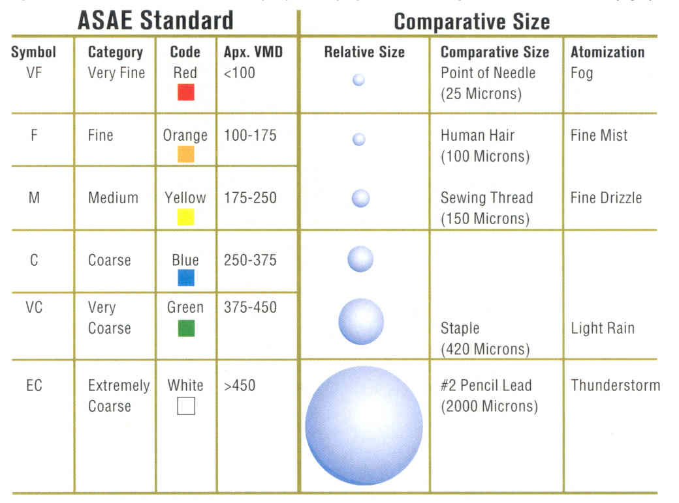
Notes:
Another/older version of droplet categories and equivalent VMDs…taken from CropLife magazine, July 2002.

